Slide 1

A Recommender System for Groceries Contractor
Applied Data Science Capstone
Pannala Subramanyam Sainath Sharma

Slide 2
Synopsis
Part 1: Problem Description
There is a groceries contractor in one of the boroughs of Toronto (Scarborough). This contractor provides places such as: Different types of Restaurants, Bakery, Breakfast Spot, Brewery and Café with fresh and high-quality groceries. The contractor wants to build a warehouse for the groceries it buys from villagers and farmers inside the borough, so that they will support more customers and also bring better "Quality of Service" to the old customers.

Slide 3
Synopsis
We will need geo-locational information about that specific borough and the neighborhoods in that borough. We specifically and technically mean the latitude and longitude numbers of that borough. We assume that it is "Scarborough" in Toronto. This is easily provided for us by the contractor, because the contractor has already made up his mind about the borough.

Slide 4
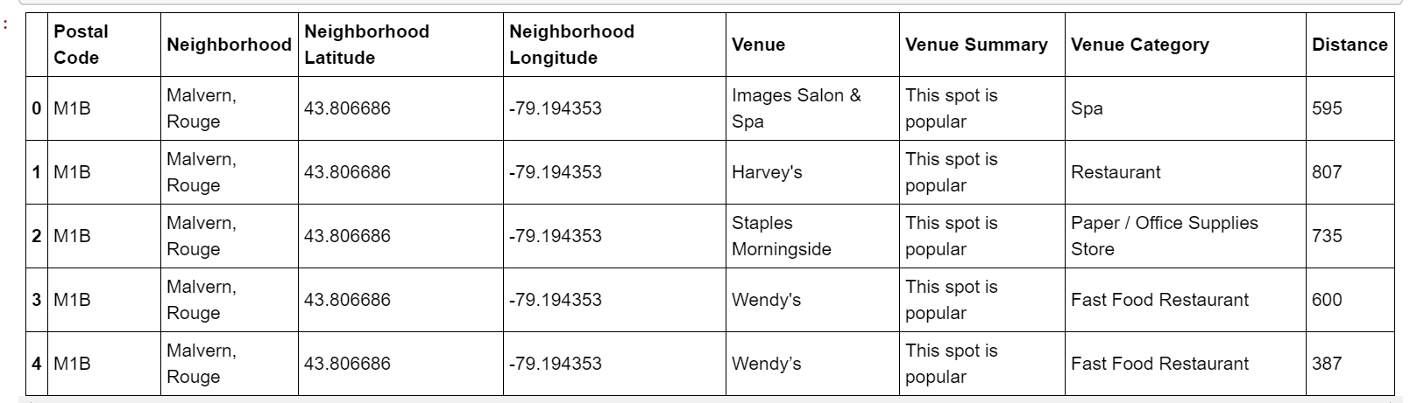
Synopsis
Part 2 – Data We Need
We will need data about different venues in different neighborhoods of that specific borough. In order to gain that information we will use "Foursquare" locational information .A typical request from Foursquare will provide us the following information:

Slide 5
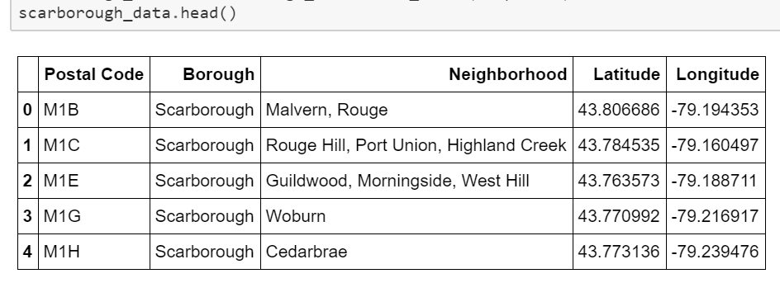
MAIN ARTICLE Part 1: Identifying Postal Codes (and then Neighborhoods) in "Scarborough

Slide 6
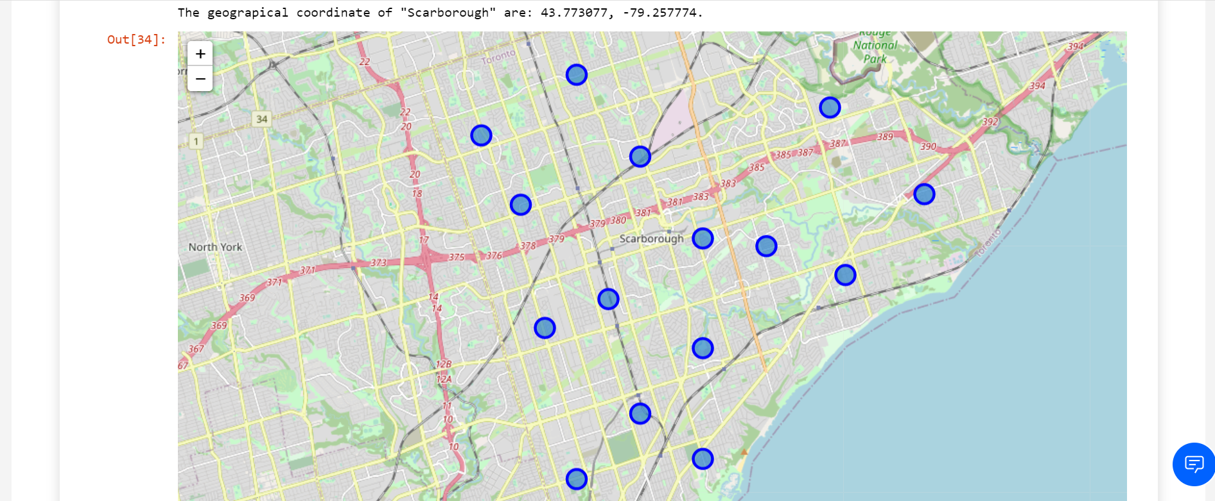
MAIN ARTICLE Part 1: Identifying Postal Codes (and then Neighborhoods) in "Scarborough

Slide 7
MAIN ARTICLE Part 2: Connecting to Foursquare and Retrieving Locational Data
for Each Venue in Every Neighborhood
After finding the list of neighborhoods, we then connect to the Foursquare API to gather information about venues inside each and every neighborhood. For each neighborhood, we have chosen the radius to be 1000 meter. It means that we have asked Foursquare to find venues that are at most 1000 meter far from the center of the neighborhood.

Slide 8
MAIN ARTICLE Part 3: Processing the Retrieved Data and Creating a Data Frame for All the Venues inside the Scarborough
When the data is completely gathered, we will perform processing on that raw data to find our desirable features for each venue. Our main feature is the category of that venue. After this stage, the column "Venue's Category" wil be One-hot encoded and different venues will have different feature-columns. After On-hot encoding we will integrate all restaurant columns to one column "Total Restaurants" and all food joint columns to "Total Joints" column.

Slide 9
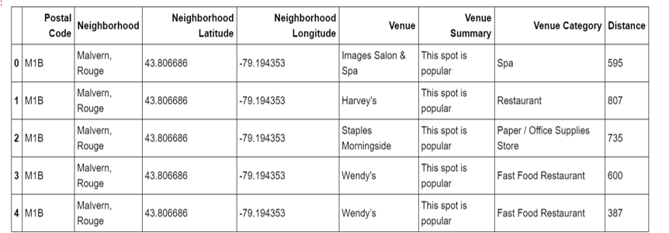
MAIN ARTICLE Part 3: Processing the Retrieved Data and Creating a Data Frame for All the Venues inside the Scarborough

Slide 10
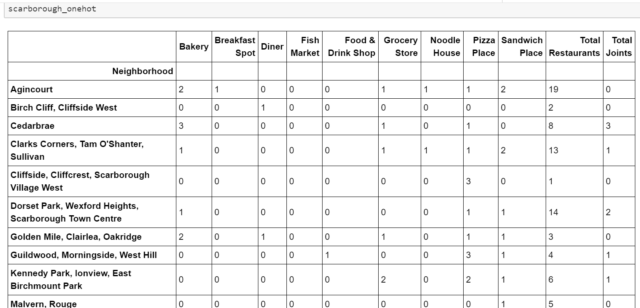
Now, the dataset is fully ready to be used for machine learning (and statistical analysis) purposes.

Slide 11
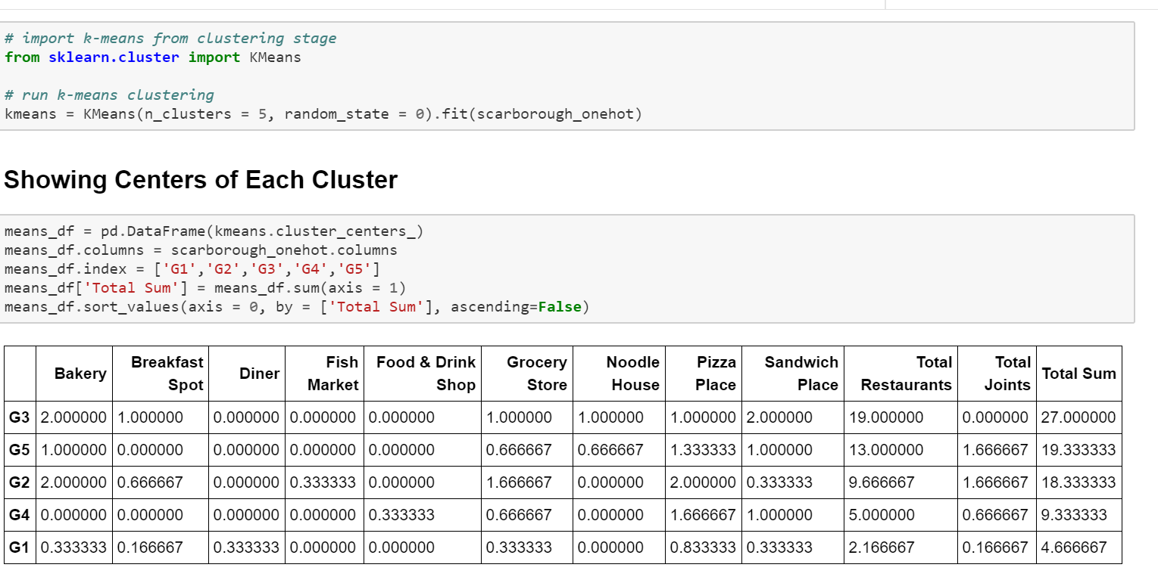
MAIN ARTICLE Part 4: Applying one of Machine Learning Techniques (K-Means Clustering)

Slide 12
Decision Making and Reporting Results
Now, we focus on the centers of clusters and compare them for their "Total Restaurants" and their "Total Joints". The group which its center has the highest "Total Sum" will be our best recommendation to the contractor. {Note: Total Sum = Total Restaurants + Total Joints + Other Venues.} This algorithm although is pretty straight forward yet is strongly powerful.

Slide 13
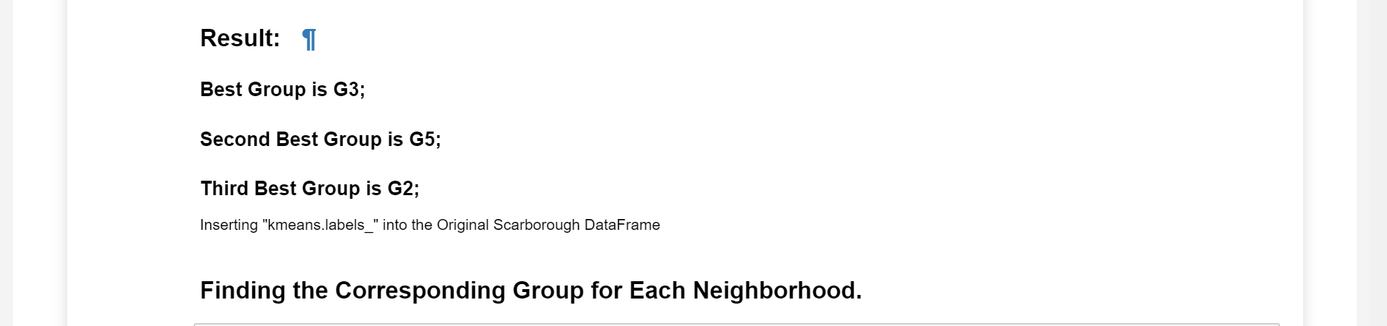
Decision Making and Reporting Results

Slide 14
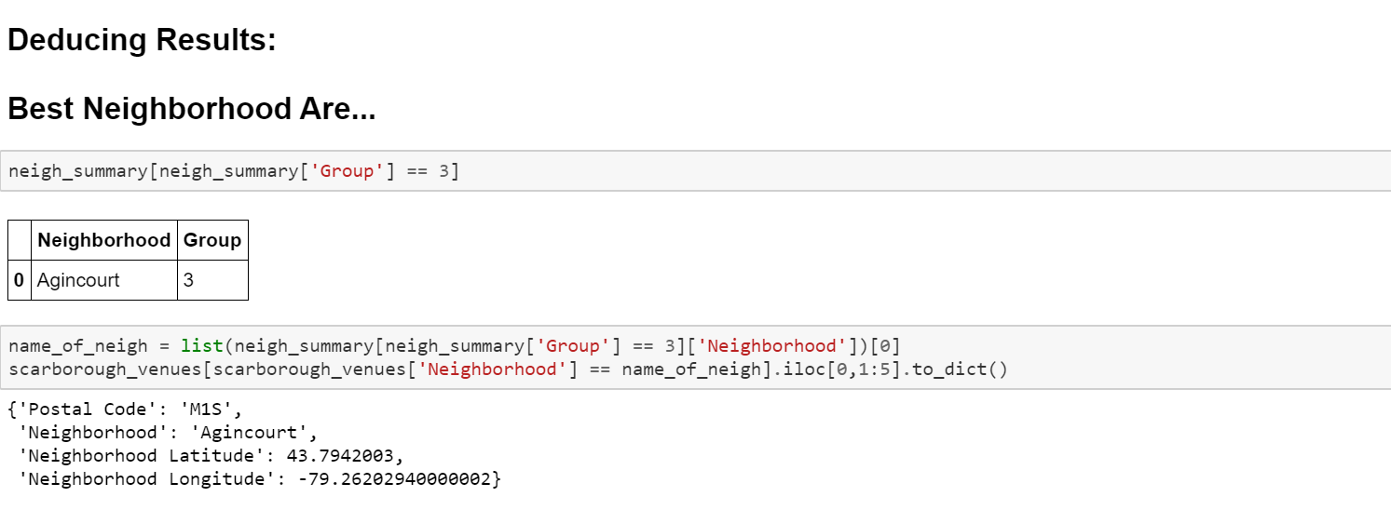
Decision Making and Reporting Results

Slide 15


THANK YOU!

